Slide 1
Combining classifiers
Data Analytics

Slide 2
Why do we combine results
What do you hope to achieve?
Classifiers may give complementary information
A very simple example
Two linear classifiers on a univariate space
Which is the best classifier?

Slide 4
Simple rule
Classify as (red) if both predict (red)
Otherwise classify as Blue
100% performance
Very simple example

Slide 5
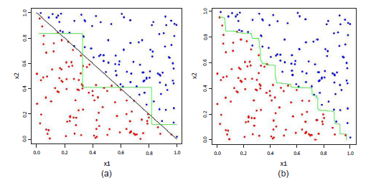
Another example
Many trees
Tree

Slide 6
Another viewpoint
25 independent classifiers each with an error rate of .35.
Ensemble predicts using majority voting
What happens if all classifiers are identical?
Assume classifiers are independent of each other.
Errors are uncorrelated
Ensemble makes a wrong prediction if more than half of classifiers predict incorrectly

Slide 7
Ensemble error rate
Maybe a little unusual to have all with exactly the same error rate and independence

Slide 8
Probability majority vote is incorrect

Slide 9
From a different view point
We are going to look at ensembles from the viewpoint of bias and variance
Continuous regression point of view
Binary point of view is a different matter

Slide 10

Bias Variance Decomposition
E{(f-t)}²=(E{f}-t)²+E{(f-E{f})²}
MSE = Bias² + Variance
For any single estimator f where t= true value
MSE=Mean Square Error
Now suppose we have a collection of f’s f₁….f_{M}
Train each separately and take average for the result -
$$\overline{f}=\frac{1}{M}\sum_{i=1}^{M}{f_{i}}$$

Slide 11

Bias-variance Decomposition
Treating the ensemble as a single estimator we can define the variance and bias
Let us look at this more closely. - M models
We can show that
$${E\{\left(\overline{f}−t\right)\}}^{2}={Bias}^{2}+\frac{1}{M}\overline{var}+(1−\frac{1}{M})\overline{covar}$$

Slide 12

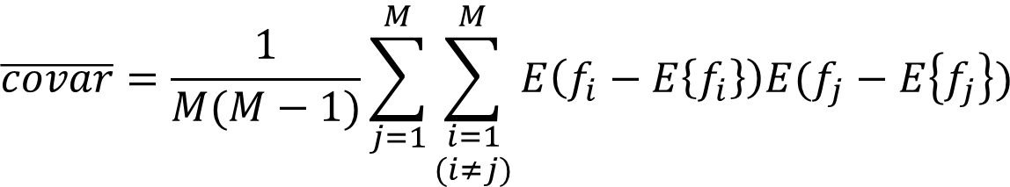
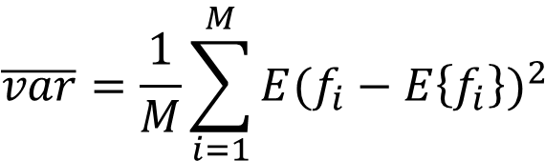
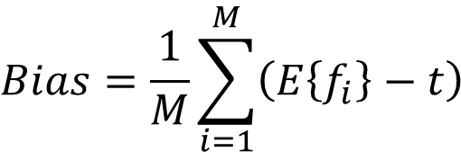
And more ….
$$Bias=\frac{1}{M}\sum_{i=1}^{M}{\left(E\left\{f_{i}\right\}−t\right)}$$
$$\overline{var}=\frac{1}{M}\sum_{i=1}^{M}{{E(f_{i}−E\left\{f_{i}\right\})}^{2}}$$
$$\overline{covar}=\frac{1}{M(M−1)}\sum_{j=1}^{M}{\sum_{\begin{aligned}i=1 \\ (i≠j)\end{aligned}}^{M}{E\left(f_{i}−E\left\{f_{i}\right\}\right)E(f_{j}−E\left\{f_{j}\right\})}}$$
$${E\{\left(\overline{f}−t\right)\}}^{2}={Bias}^{2}+\frac{1}{M}\overline{var}+(1−\frac{1}{M})\overline{covar}$$

Slide 13
Why?

Slide 14
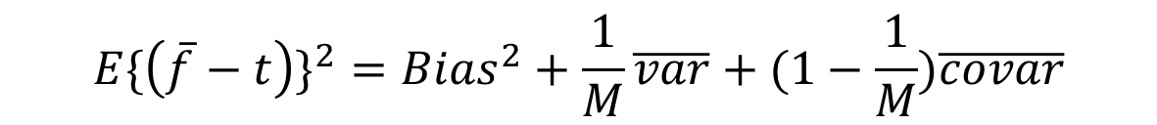
So what
$${E\{\left(\overline{f}−t\right)\}}^{2}={Bias}^{2}+\frac{1}{M}\overline{var}+(1−\frac{1}{M})\overline{covar}$$
Bias stays the same
When each model is constructed independently variance of the committee reduces by a factor of 1/M
Tighter predictions
What about the covariance term?

Slide 15
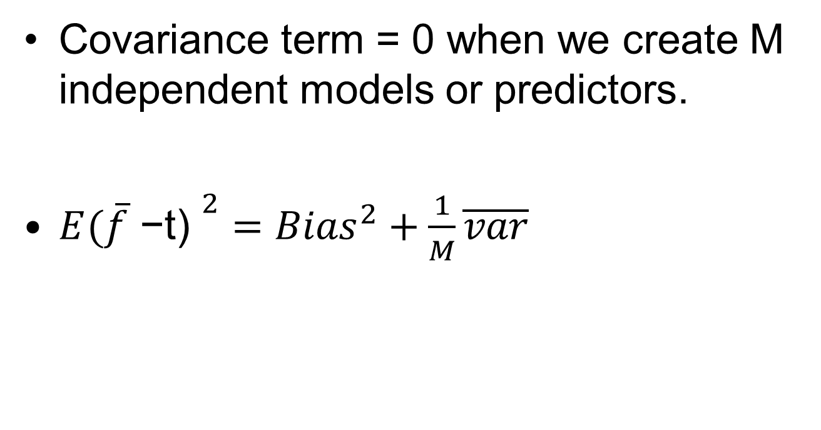
Covariance term
Covariance term = 0 when we create M independent models or predictors.
${E(\overline{f}\text{ −}\text{t}\text{) }}^{2}={Bias}^{2}+\frac{1}{M}\overline{var}$

Slide 16
Bias and variance
Bias may be viewed as an ability to approximate function
Variance of an estimator describes how an estimator value ranges from dataset to dataset

Slide 17
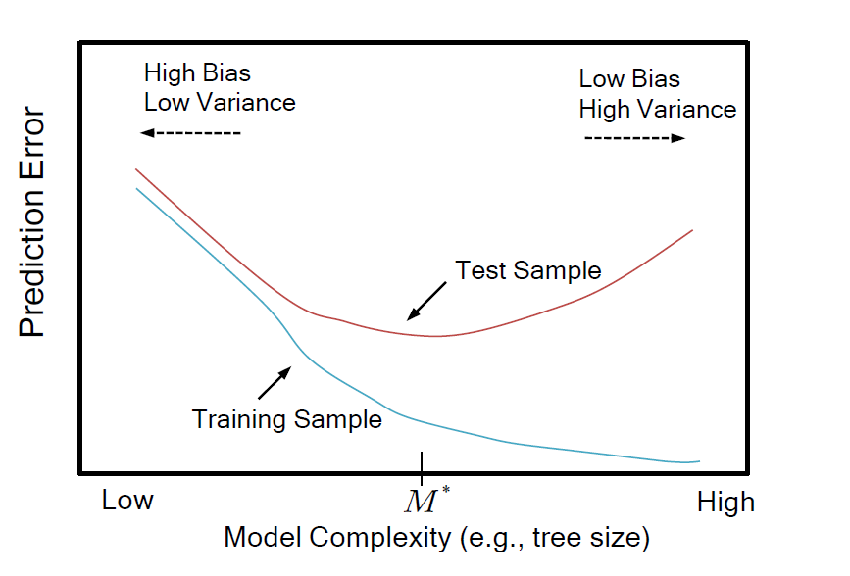

Slide 18
Calculating Bias and Variance
Create M bootstrap samples from original dataset
Train model(tree) on each of these bootstrap samples
For each observation calculate mean prediction of these M trees
Calculate variance of predictions for each obs
Calculate Bias for each obs.
Look at appropriate graphs
Calculate mean bias/absolute bias and mean variance.

Slide 19
So what?
What message does this have us for building ensembles?
Binary outcome variables
No unique decomposition of the Mean Square Error
Hope to get a decrease in the misclassification rate
But it can be worse in certain situations

Slide 20
General Idea

Slide 21
Quotation
“The collective knowledge of a diverse and independent body of people typically exceeds the knowledge of any one individual and can be harnessed by voting”
The Elements of Statistical Learning

